Slide 1


Identification and Characterization of Spiroplasma in Anopheles gambiae mosquitoes
Presenter: Towett Sharon
Endosymbiont-based strategies to block vector-borne diseases transmission has been promising (e.g Dengue).There is great interest in using endosymbionts to control vector borne parasites (e.g Plasmodium)
Study of Spiroplasma a heritable bacteria forms the basis of understanding its prevalence and its effects in Anopheles gambiae mosquito as a potential candidate for vector control

Slide 2
Objectives
To determine the prevalence of Spiroplasma species in natural populations of Anopheles gambiae mosquitoes
To determine vertical transmission of Spiroplasma
To investigate the population dynamics of Spiroplasma species in Anopheles gambiae mosquitoes by determining the mtDNA haplotypes associated with infected and non-infected samples

Slide 3
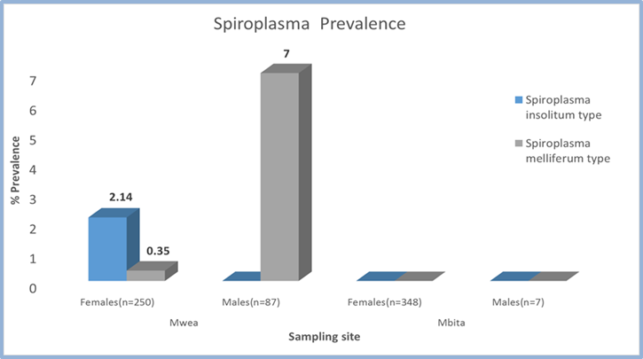
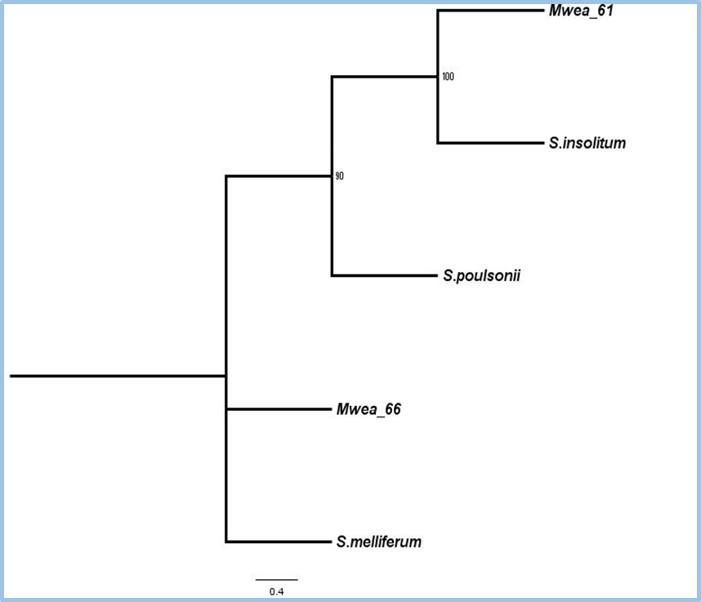
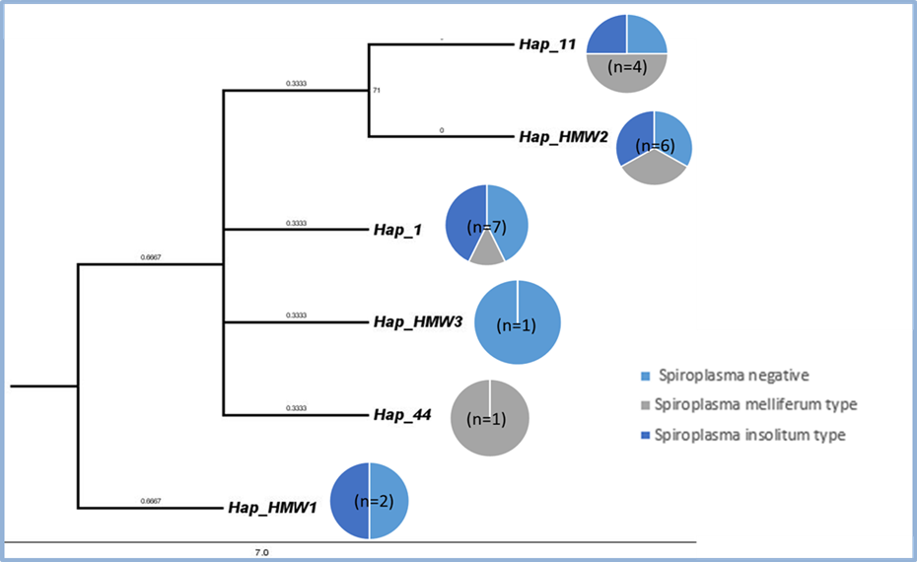
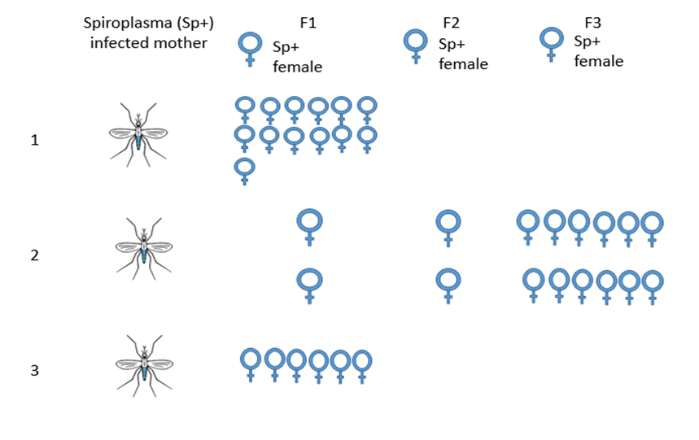
Results
Figure 1: Infection status of Spiroplasma in Anopheles gambiae
Figure 2: Molecular phylogenetic analysis of Spiroplasma in Anopheles gambiae
Figure 3: mtDNA phylogenetic tree of Spiroplasma infected and non-infected samples
Figure 4: Vertical transmission of Spiroplasma from mother to offspring

